Slide 1





Bank of Baroda
Hackathon 2024
Team Name : Local-host
Team bio :
We are a team of IIT Madras students with diverse skills in app development, generative AI, machine learning, artificial intelligence, frontend, and backend development. All team members are passionate and dedicated to delivering innovative solutions.
Date : 30 June 2024

Slide 2


GenServAI: Transforming Customer Support with Generative AI
Customer Pain Point: Many customer service systems are slow and impersonal.
Efficiency: AI can automate inquiries, providing accurate, real-time responses.
Personalization: Leveraging customer data for tailored solutions enhances satisfaction.
Innovation: Integrating generative AI can revolutionize customer support.

Slide 3
Pre-Requisite
Chatbots: Basic automation but often lacks depth and personalization.
CRM Systems: Provide data but require manual intervention.
Voice Assistants: Good for basic tasks but limited in understanding complex queries.
Help Desk Software: Efficient for ticket management but not real-time.

Slide 4


Tools or resources
Azure Cognitive Services: For language understanding and speech recognition.
Azure Machine Learning: To train and deploy AI models.
Azure Bot Service: For creating intelligent bots.
Azure SQL Database: For managing customer data securely.

Slide 5
Any Supporting Functional Documents
Methodology: Agile development with iterative testing and deployment.
Architecture: Microservices with a RESTful API backend and React frontend.
Scalability: Cloud-native design using containers and orchestration tools.

Slide 6
Key Differentiators & Adoption Plan
AI-Powered Personalization: Unique, real-time, data-driven responses.
Integration: Seamless with existing platforms ensuring smooth transitions.
Security: Advanced measures for data privacy and integrity.
Adoption Plan: Pilot with select customers, gather feedback, and iterate for broader deployment.

Slide 7
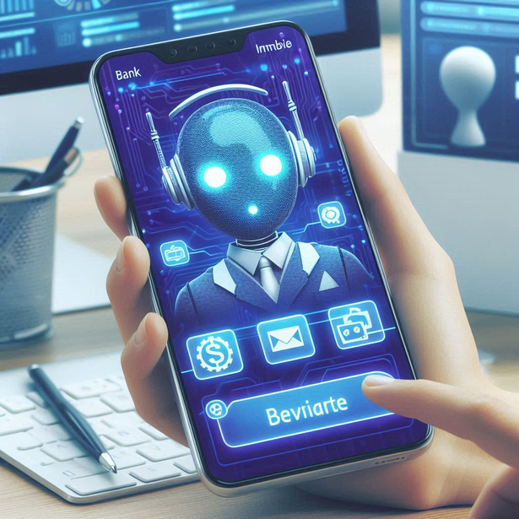
GitHub Repository Link & supporting diagrams, screenshots
GitHub Repository: Repo Link Here
Potential: Wide adoption in customer-centric industries like retail, finance, and healthcare.
Support: Diagrams of architecture and screenshots of the prototype for visual clarity.

Slide 8
Business Potential and Relevance
Generative AI: Creates highly personalized and contextual responses.
Multichannel Integration: Consistent experience across web, mobile, and voice.
Proactive Support: Predictive analytics to anticipate customer needs.

Slide 9
Uniqueness of Approach and Solution
Personalized Interactions: Each customer feels valued and understood.
Real-Time Support: Immediate assistance without long wait times.
Unified Experience: Consistent support across all channels.

Slide 10
User Experience
Cloud-Based Architecture: Easily scale resources as needed.
Microservices: Independent scaling of components ensures performance.
Load Balancing: Efficiently distribute traffic to avoid bottlenecks.

Slide 11
Ease of Deployment and Maintenance
Deployment: Automated CI/CD pipelines for seamless updates.
Maintenance: Modular design allows easy updates and troubleshooting.
Documentation: Comprehensive guides and support for easy onboarding.

Slide 12



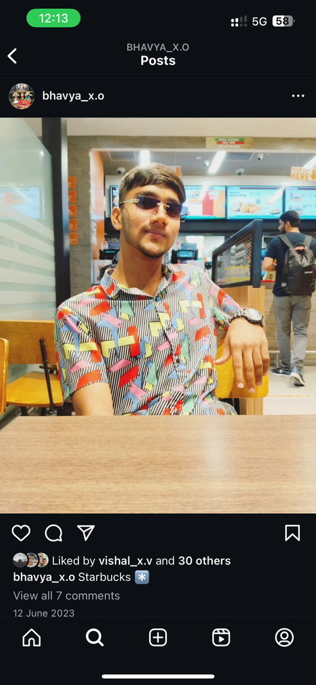
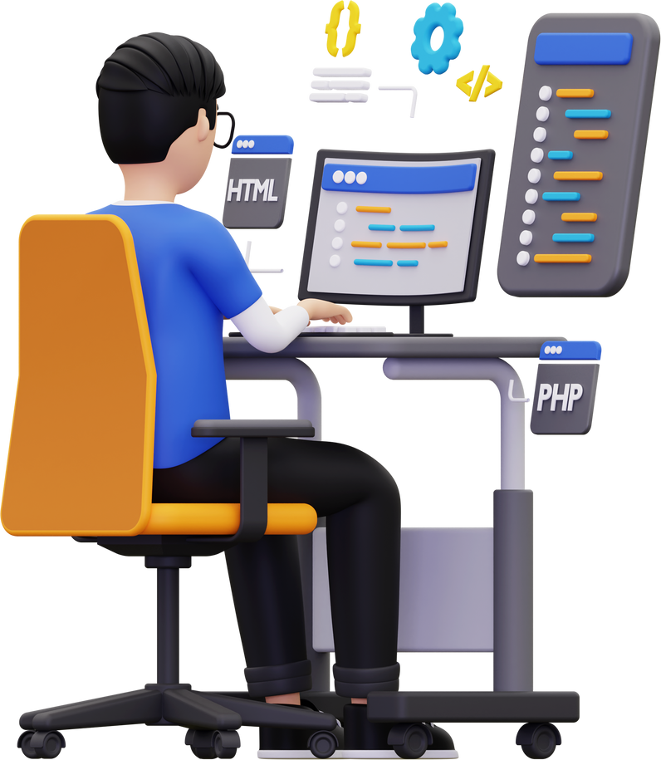
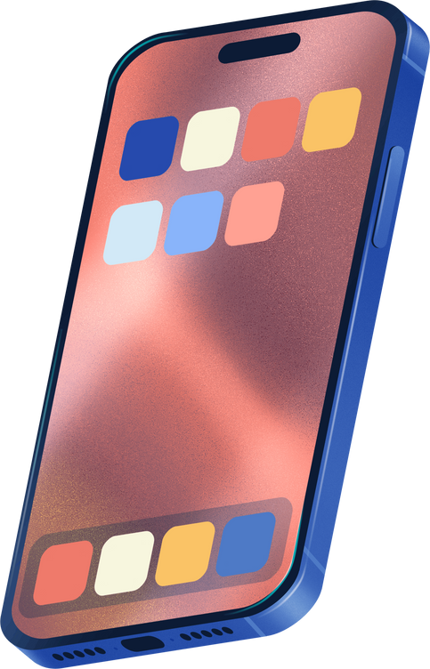
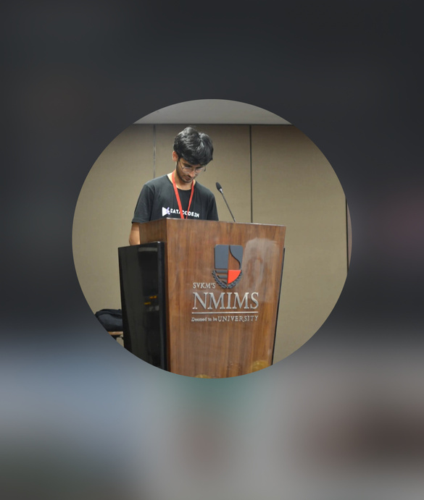
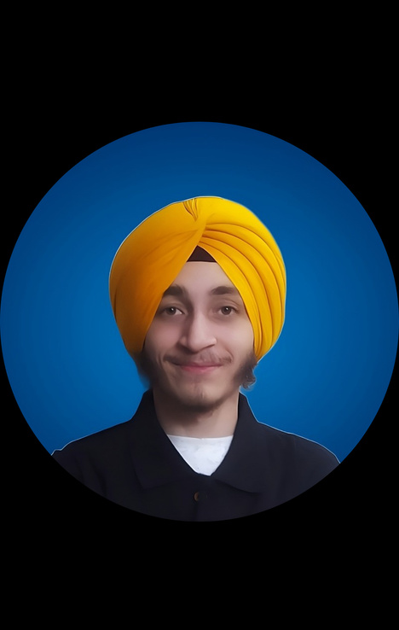
Thank You
Shivam Sharma
Bhavya Vishal
Team Lead (App Developer)
Gen AI
Shivam Bhawar
Parampreet Singh
Development & ML
Backend & ML

